Slide 1
Building response
reactive applications
(using reactive streams)
Notes:
Hi, I’m James,
And, I’m going to talk a bit about building responsive reactive applications, using reactive streams.
But first I’ve got to say I’ve not done a lot of public speaking, I’ve only done weddings speeches previously…. And I’ve been banned from telling any jokes….
Which is a shame because I had a really good Fibonacci joke….
but I was told it was as bad as the last two jokes you heard combined
But anyway that’s the kind of community we want to have here, where anybody can come along and contribute.
So let’s start...

Slide 2
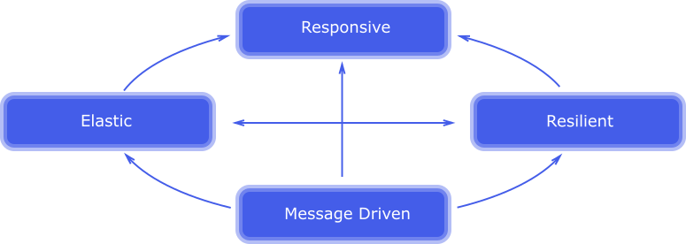
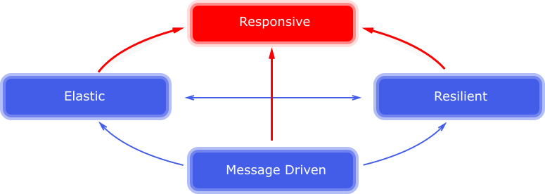
Responsive - at the System Level
System is able to cope with load, autoscales appropriately
Fault tolerant and available, even when errors occur
Communication tool between reactive system components that enables: load management, loose coupling, location transparency.
Notes:
Diagram from the Reactive Manifesto…
Some of the arrows point in one direction
Some two directions (elastic and resilient)
Everything points to ONE BIG FAT LAZY ENTITY AT THE TOP
Yup… RESPONSIVE
And it points to nothing ELSE
Being responsive occurrs as a result of the other entities’ efforts.
[CLICK FOR TEXT]
Neil and Ben have done a great job of already covered off of the things that make a System as a whole : responsive. But at the Application level, I think there’s a bit more to be done… And over the last few years we’re we’re seeing a massive uptake in usage in Reactive Streams to build:
Event driven
Fault Tolerant
Responsive
Applications.

Slide 3

But how?!
BUT HOW?!
Notes:
I’m going to give you 5 Tips which you can take away to help you build responsive, resilient, and reactive applications

Slide 4

Tip 1: Prefer Asynchronous operations
Hi...
It seems you’re wanting to perform Asynchronous Operations?
I’ve been doing them for years, you don’t need any fancy “Reactive” frameworks
Asynchronous requests can be thought of as happening “in the background”
Allows your application to continue processing other tasks, without blocking on the previous task.
Unless your application is simple, you’ll usually want to perform multiple asynchronous operations.
New Reactive Frameworks are great for creating and composing asynchronous requests
Notes:
Aaah this guy!?
He’s got a point though…
Java has been able to Asynchronous operations for years… so we don’t need any Libraries for that… right?
Let’s see what’s wrong with what we’ve got

Slide 5
public Future<T> getData(...)
Asynchronous, but...
There’s a tendency to block immediately getting the future:
future.get();
Composability can get tricky...
Future<List<Future>> getData(...)
[...]
for (future f : futureList) {
f.get(); // weep
}
Notes:
Added in Java 1.5
Let’s see some code...

Slide 6
try {
Future<A> aFuture = api.getA();
A a = aFuture.get();
Future<B> bFuture = api.getB(a);
B b = bFuture.get();
Future<C1> c1Future = api.getC1(b);
Future<C2> c2Future = api.getC2(b);
Future<D> dFuture = api.getD(c1Future.get(), c2Future.get());
D d = dFuture.get();
updateUI(api.getE(d).get());
} catch (InterruptedException | ExecutionException ex) {
handleError(ex);
}
try {
Future<A> aFuture = api.getA();
A a = aFuture.get();
Future<B> bFuture = api.getB(a);
B b = bFuture.get();
Future<C1> c1Future = api.getC1(b);
Future<C2> c2Future = api.getC2(b);
Future<D> dFuture = api.getD(c1Future.get(), c2Future.get());
D d = dFuture.get();
updateUI(api.getE(d).get());
} catch (InterruptedException | ExecutionException ex) {
handleError(ex);
}
Notes:
Imagine you have a series of network reuqests…
You need an A to make a request for B
You need a B to get a C1 and a C2
…
[CLICK] TO see get()s
So all this premature blocking is sub optimal. Blocking is bad for reactive systems.

Slide 7
public void getData(Callback<T> c);
Asynchronous
Push-based
+ / - Composable, usually nested
Notes:
FULLY Asynchronous!
An example of the Deferred execution
Less chance of the premature blocking we saw with Future…

Slide 8


api.getA(a -> {
api.getB(a, b -> {
api.getC1(b, c1 -> {
api.getC2(b, c2 -> {
api.getD(c1, c2, d -> {
api.getE(d, e -> {
updateUI(e);
});
});
});
});
});
});
The indent level of a function should not be greater than one or two!
If you need more than 3 levels of indentation, you're screwed!
Notes:
[CLICK] to see uncle bob
[CLICK] to see Linus Torvalds
These guys have got a point,
Bob wrote the Bible on clean code,
the other wrote arguably the most important piece of software in history: linux Kernel
So these guys are talking about how code complexity increases with each indent,
but it also increases in complexity when you factor in deferred execution.
Hence why this is called: callback hell
--------------
So I’m not entirely sold on either of these…
Hmm I wonder what happens if you take a future and glue a callback onto it?

Slide 9
CompletableFuture<T> getData(...)
Future + Callback = CompletableFuture
Asynchronous
Composable (thenAccept()/thenCombine()/runAfterBoth()/etc...)
Push based data retrieval
Implemented in:
Guava ListenableFuture,
Akka Composable Future
Java 8 CompletableFuture
Notes:
Guavas ListenableFuture came out in 2007
Oracle finally copied it in 2014, you know Java’s getting a bit old now so you have to give it time to catch up!

Slide 10
CompletableFuture<B> bComp = api.getA()
.thenCompose(a -> api.getB(a));
bComp.thenCompose(b -> api.getC1(b))
.thenCombine(bComp.thenCompose((B b) -> api.getC2(b)),
(c1, c2) -> new Pair<>(c1, c2))
.thenCompose(pair -> api.getD(pair.first, pair.second))
.thenCompose( d -> api.getE(d))
.handle((e, throwable) -> {
if (throwable == null) {
updateUI(e);
} else {
handleError(throwable);
}
return e;
});
// FYI: thenCompose == flatMap

Slide 11
CompletableFuture<T> getData(...)
Composability is ok
Eagerly evaluated, need to process all of the data before we can move onto the next completion stage. (It’s just a placeholder for the result).
Notes:
Composability is adequate, functional style methods provided are good for composing but they stop there and you’re back in the imperative world, there’s nothing to process, transform, reduce, that data
If you’ve got to this point in your code you probably don’t have that many headaches with this stuff…
but I think there’s something more flexible, more suited to way that data is consumed these days.

Slide 12
public Observable<T> getData(...)
Asynchronous
Cardinality: one, many, or infinite items
Very composable, in a functional/declarative way
Data is pushed to the client/subscriber, from the source
Lazily evaluated - only process the data you need to process.
Client/
subscriber
notify
push
Source
emit
push
Data direction
Notes:
Let me introduce you to A reactive stream…
You can think of this as a dataflow pipeline...
I’m using an Observable here, because the particular flavour of Rx Stream I’m most familiar with… There’s also Flux if you use Reactor Core, ___ If you use Akka streams, or Flowable if you use the Java 9 Flowable API...

Slide 13
api.getA()
.flatMap(a -> api.getB(a))
.flatMap(b -> zip(api.getC1(b), api.getC2(b),
(c1, c2) -> new Pair<>(c1, c2)))
.flatMap(cPair -> api.getD(cPair.first, cPair.second))
.flatMap(d -> api.getE(d))
.subscribe(val -> updateUI(val),
err -> handleError(err));
api.getA()
.flatMap(api::getB)
.flatMap(b -> zip(api.getC1(b), api.getC2(b), Pair::new))
.flatMap(cPair -> api.getD(cPair.first, cPair.second))
.flatMap(api::getE)
.subscribe(this::updateUI, this::handleError);
Notes:
I find this really easy to read,
very easy to combine asynchronous data sources,
[CLICK] METHOD REFERENCES

Slide 14
Feature vs Emoticon matrix
 | Async | Composable | Push | Lazily Evaluated | 1/many/∞
Future | ಠ_ಠ | ( ͡° ͜ʖ ͡°) | (╥﹏╥) | (╥﹏╥) | (╥﹏╥)
Callbacks | ( ͡° ͜ʖ ͡°) | (╯°□°）╯︵ ┻━┻ | ( ͡° ͜ʖ ͡°) | (╥﹏╥) | (╥﹏╥)
Completable Future | (⌐■_■) | ( ͡° ͜ʖ ͡°) | (⌐■_■) | (╥﹏╥) | (╥﹏╥)
Reactive Streams | (⌐■_■) | (⌐■_■) | (⌐■_■) | (⌐■_■) | (⌐■_■)
Notes:
And we’re only really scratching the surface of reactive streams, many functions
transform,
limit,
Combine
Reductions
Group
sorting
OR define your own operators
THIS IS WHERE WE Want to be in terms of reactive applications….
This is why Reactive Streaming APIs such as RxJava and Reactor are getting so popular!

Slide 15
What is a Reactive Stream?
WTF?! Deviation
Observer Pattern enhanced:
onNext(T thing) onError(Throwable t) onComplete()
An Asynchronous and Push based version of Iterable<T>
 | Iterable (pull) | Observable (push)
retrieve data | T next() | onNext(T)
discover error | throws Exception | onError(Exception)
complete | !hasNext() | onCompleted()
Notes:
[OPTIONAL] RxJava is:
Set of Classes for representing sources of data (as a stream)
Set of Classes for listening (or observing) to data sources
A set of Operators to transform, composing, aggregate, reduce, collect the data

Slide 16
For example...
Observable.merge(ftse100(), nasdaq(), tokyoSE())
.sorted()
.take(10)
.subscribe(new Observer<Instrument>() {
@Override
public void onNext(Instrument value) {
printInstrument(value);
}
@Override
public void onError(Throwable e) {
handleError(e);
}
@Override
public void onComplete() {}
}
);
Instrument | Sector | Price
ANTO | Ecommerce | 462
AZN | Trading | 460
NG. | IT | 454
HSBA | Ecommerce | 441
SGE | IT | 433
STAN | Banking | 407
BRBY | Telecommunications | 395
PSN | Trading | 393
REX | IT | 386
ADN | IT | 374

Slide 17

Tip 2: Utilise Your Cores!
Multi-core systems (and Hyper-threading) are commonplace
The JVM is extremely performant, heavily optimized, mutli-threaded machine!
THIS IS FINE
So just learn and apply the following as appropriate:
Thread, Runnable, Callable, Future<T>, Executor, Executor Service
, Executors, Synchronized, ReentrantLock, ReadWriteReentrantLock, StampedLock, wait(), notify(), volatile, AtomicInteger, AtomicReference, Condition, TimerTask, NEW/RUNNABLE/BLOCKED/WAITING/TIMED_WAITING/TERMINATED, ConcurrentMap, ConcurrentHashMap, ConcurrentLinkedDeque, PriorityBlockingQueue, Phasers, CountdownLatch, ForkJoinPool, Delayed, RunnableFuture, RunnableScheduledFuture, TransferQueue, Exchanger, Semaphore, Splitterators, Cyclic Barrier, ConcurrentSkipListMap, ForkJoinPool, ForkJoinWorkerThread...
but don’t cause...
Deadlock, Race conditions, Lock Starvation, Livelock, Memory Consistency Errors, Unnecessary Memory Barriers, etc...
Notes:
MULTICORE IS COMMON
Your phone is millions of times more powerful than all of the NASA computers that put the man on the moon
The JVM is 25 years old and is heavily optimzed for concurrent and parallel execution.
-----------------------------------
So this is Basic Concurrency Java 101....
Although extremely powerful, it’s fair to say that Java has a pretty poor reputation for the producing thread safe, concurrent code, easily.
The Fact is Multi threaded code is hard to:
WRITE
TEST
DEBUG
There has to be a better way…..

Slide 18
… Or prefer a more modern, high level abstraction
// API:
Observable<Things> getThingsObservable() { ... }
//Client
getThingsObservable()
.subscribeOn(Schedulers.io())
.observeOn(Schedulers.computation())
.map(longProcessingTask())
.observeOn(uiThread())
.subscribeOn(updateView());
Focus on business logic, not multithreading logic
Utilise your cores where appropriate
Allow your thread that the user/ client interacts with the system to remain responsive (don’t block!)
Get some “Things” on the IO scheduler
Process the things, on the Computation scheduler
Send the processed data to the UI/View
Notes:
I really Like this, in my years I’ve not worked with any framework that allows you to hop around with threads like this
And it’s all because preferring immutable state, and Functional Programming,
Which is a shame, as we all know, the worst thing about Functional Programming, is the Smug Functional Programmers.

Slide 19
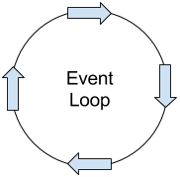

… it’s actually unopinionated about how you implement your concurrency
Thread-pools
Single threads
Actors (e.g. Akka)
Event loops
Non-blocking I/O
Something else?!
Schedulers provide the abstraction layer between the stream and the underlying implementation.
f (x)
Schedulers
Thread pool btw!
Notes:
Which is pretty cool, if you think about ListenableFuture, or Completable future, they just take Executors services (thread pools).

Slide 20
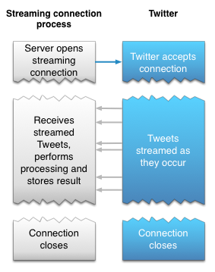
Tip 3: Use Streaming APIs and Protocols
Request and Response style APIs are showing their age
polling for updates is inefficient
WebSockets allow full duplex communication
HTML5 Server Sent Events allow one way updates*
Also:
Twitter: Firehose Streaming API
Netflix/Facebook: ReactiveSocket
Google: GRPC
© Twitter 2017
* supported in all browsers except IE / MS Edge
Notes:
Req->Response - Apps we’ve built for years, doing stuff like CRUD, are showing their age.
And as Neil said, times are changing and the industry is moving towards more interactive methods...

Slide 21
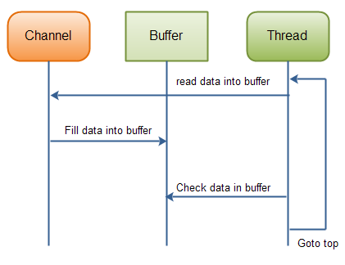
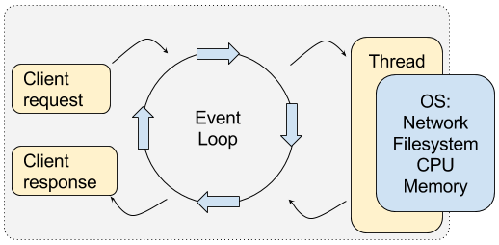
Tip 4: Prefer non-blocking I/O
I/O operations that “block” threads, leaves CPU under-utilised
Using non blocking:
reduces the number of threads needed
greatly reduces the memory requirements
Typical implementations:
Buffered writes
Event Loops
e.g. Java 1.5 nio/2 / Netty / AsyncHttpClient
See Netflix’ research in the slide notes, RxNetty vs Tomcat.
© Jacob Jenkov
Notes:
[CLICK to see non blocking Buffered writes]
[CLICK to see Event loops]
This is important if you consider the traditional THREAD PER REQUEST approach applied by the Servlet containers like Tomcat.
Where Request comes in, it is assigned a thread, does it’s work, responds, and then puts the thread back in the pool…
That’s been fine for years but….
If you think back a slide and remember everyone is moving towards Reactive APIS, how well do you think it is going to cope when we have to provide updates to the client?
Well, luckily you don’t have to think, because Netflix have done the research to show that Non blocking IO….

Slide 22

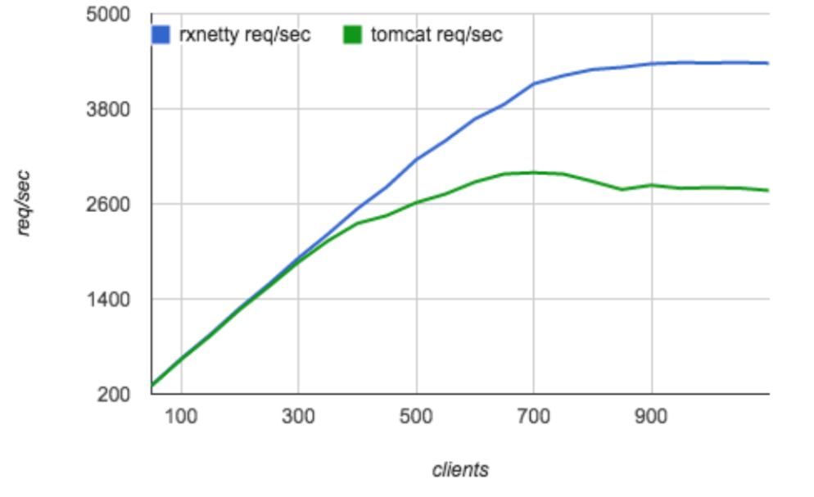

Netty handles more requests per second...

Slide 23
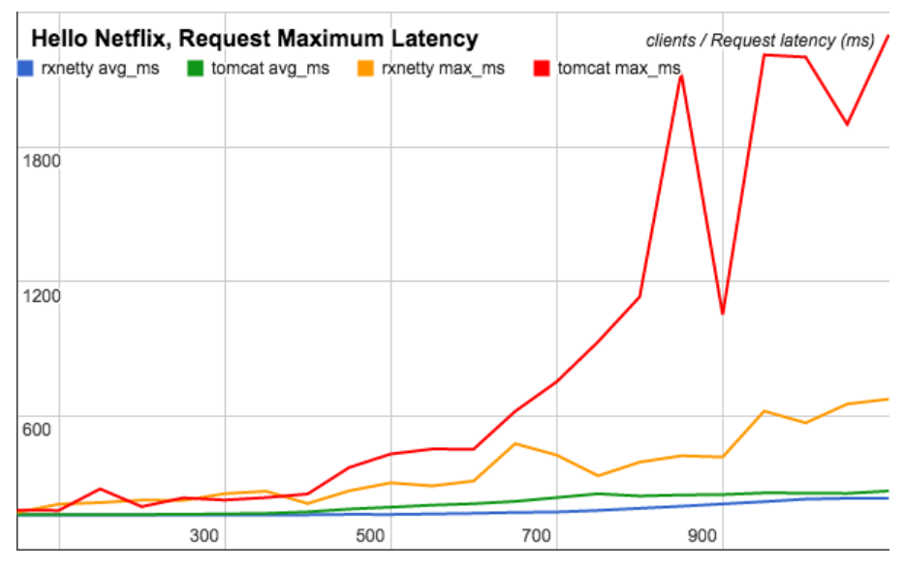
… at a much lower request latency
Notes:
And this is because there’s less threads blocking on IO requests, freeing up memory
it’s just a different approach that seems to works well
These tests were executed in situations where systems are network and IO bound.
Which certainly in my experience is true, most services I have written in the past were
calling other services
Writing to / reading from databases
Using Queues
Etc
I should point out that Tomcat has special Non-blocking HTTP IO connectors for use with things like websockets. This is not an attack on Tomcat, I actually like Tomcat.

Slide 24
Tip 5: React to errors
Reactive Streams = Observer pattern++
onError
As defined by the contract: Errors are first class citizens
Errors are pushed, as opposed to usual try/catch (pull). Meaning they are consumed as early as possible.
api.getA()
.subscribe(this::updateUI, this::handleError);
Notes:
My last and final tip
Like a typical developer, I’ve left error handling until last.
Another nice addition there is in reactive streams that they took the observer pattern from the Gang of Four book, and built in Errors, and made them first class citizens.

Slide 25
Utilise Backpressure/Flow Control
Backpressure is a way to inform the data source that you cannot process as fast as they are sending.
Flow Control is attempting to deal with the rate at which the data source is sending them
Notes:
Utilising these can allow your application to remain resilient, in the face of an increase in data to process.
Let’s have a look at how these look...

Slide 26
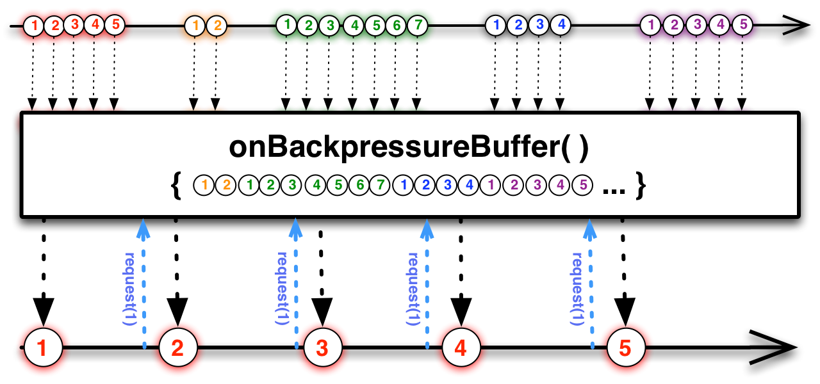
Buffering….
Notes:
Observable at the top is the source.
Middle box is the operator
Lower stream is the observable after the operator.

Slide 27
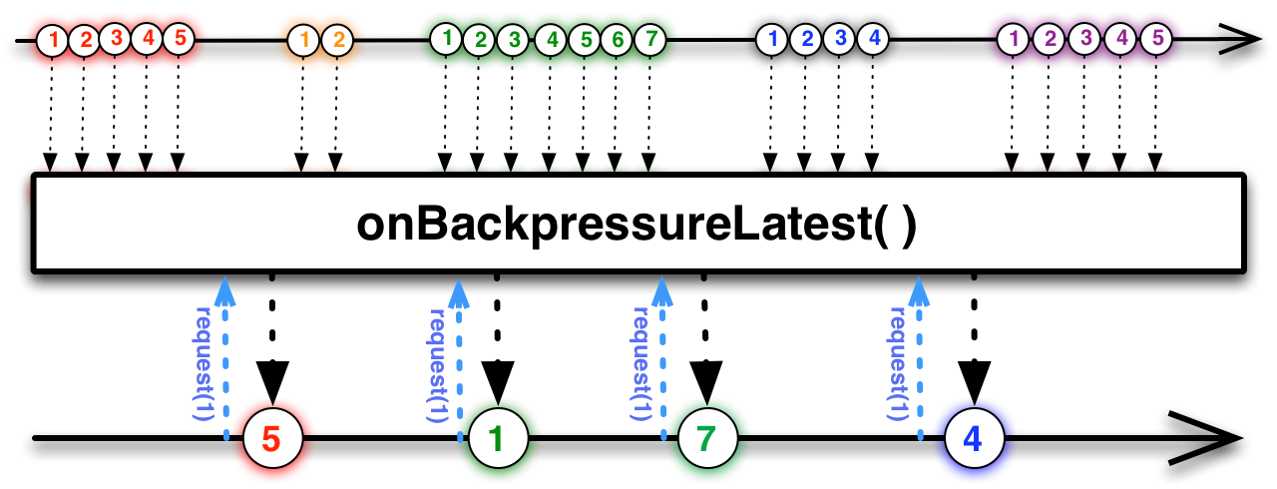
Latest...

Slide 28
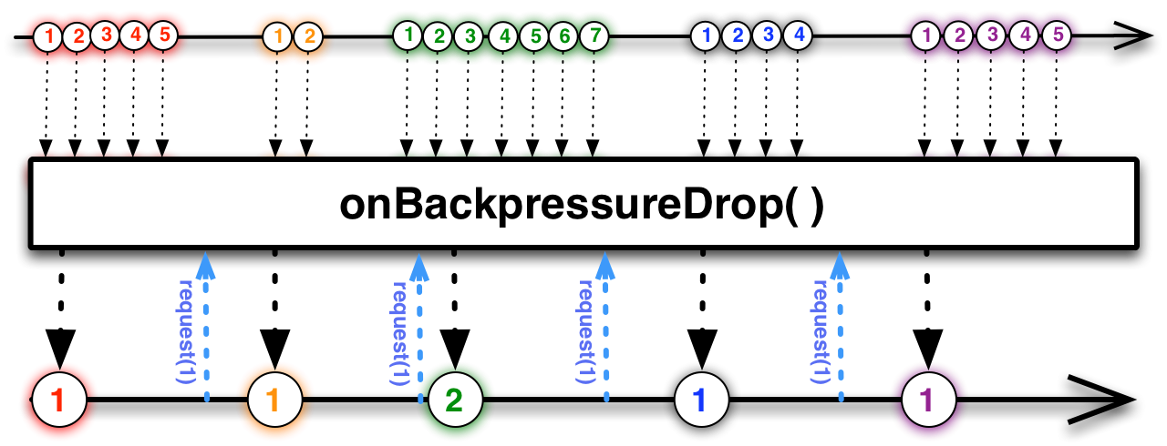
Dropping...

Slide 29
RxJava Info / Summary
Reactive Extensions; created by a crazy dutch genius; Erik Miejer (Micro$oft)
Netflix created a Java version, implemented their whole service layer with it.
“Reactive Extensions” is Polyglot project: C#, Java, JS, Scala, Kotlin, Swift, Clojure, Groovy, C++, Python, + more in future
RxJava itself doesn’t target Java, it target the JVM.
Notes:
Erik Miejer - if you want your mind blown, go on google and watch some of his talks about FP and Reactive programming
RxJava itself doesn’t target Java, it target the JVM. Interop with other languages.
Reactive Stream Commons - working alongside pivotal - working on Reactor

Slide 30
RxJava Info / Summary
Implements the Reactive Streams standard, which is being incorporated into Java 9
...also implements the Reactive Stream Commons, (standardises operators across Reactive Stream Implementations)
Library, not a framework (1.2MB!)
Compatible with Java 6
Notes:
...Java 9 if it ever gets released
If you do use java 6 I would recommend you check out retrolambda, or use intellij code folding. Other IDEs are available.

Slide 31
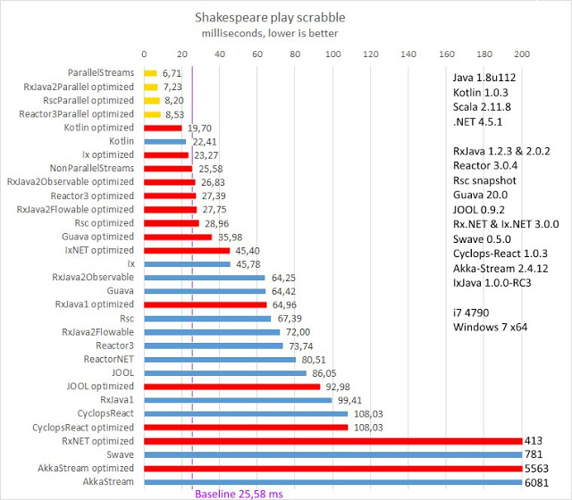
Java 8
RxJava 2
Reactor 3
Kotlin
Guava
RxJava1
Akka

Slide 32
Summary
blocking = bad
Notes:
Reactive libraries are extremely powerful, but can have a steep learning curve.
The developer has to have a mental shift
Imperative to Functional
Sync to Async
Pull to Push
And if you have underlying problems in your application you may just well end with Observable Stream of Problems.

